Slide 1
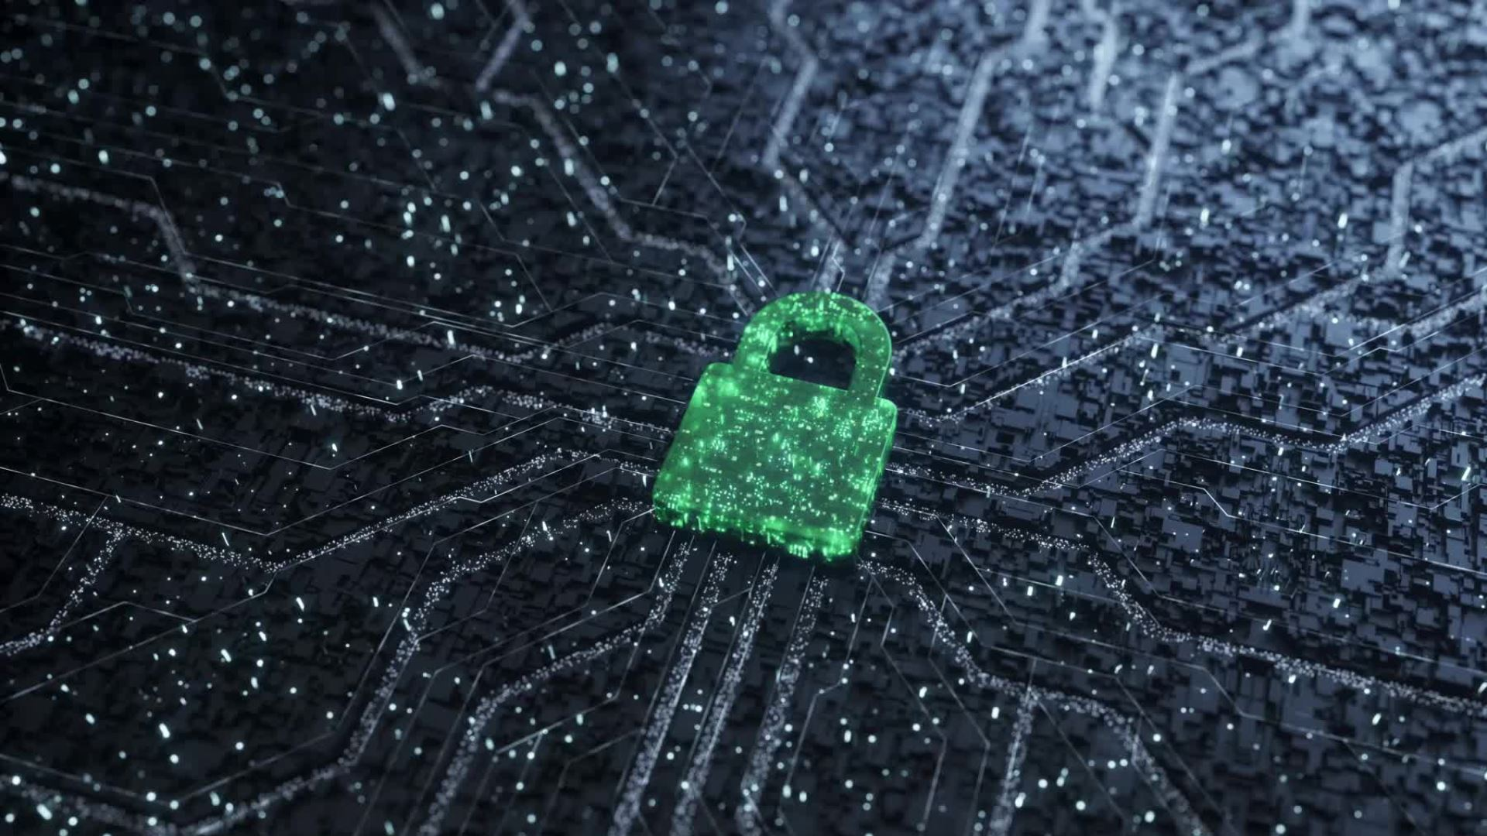

Cyber Security Activities
Social Engineering
Caeser Cipher (Cryptography)
Notes:
THE IMITATION GAME - Official UK Trailer - Starring Benedict Cumberbatch
https://www.youtube.com/watch?v=j2jRs4EAvWM

Slide 2

Outline of the session - Introduction - Cyber Security Activity 1 - Cyber Security Activity 2

Slide 3
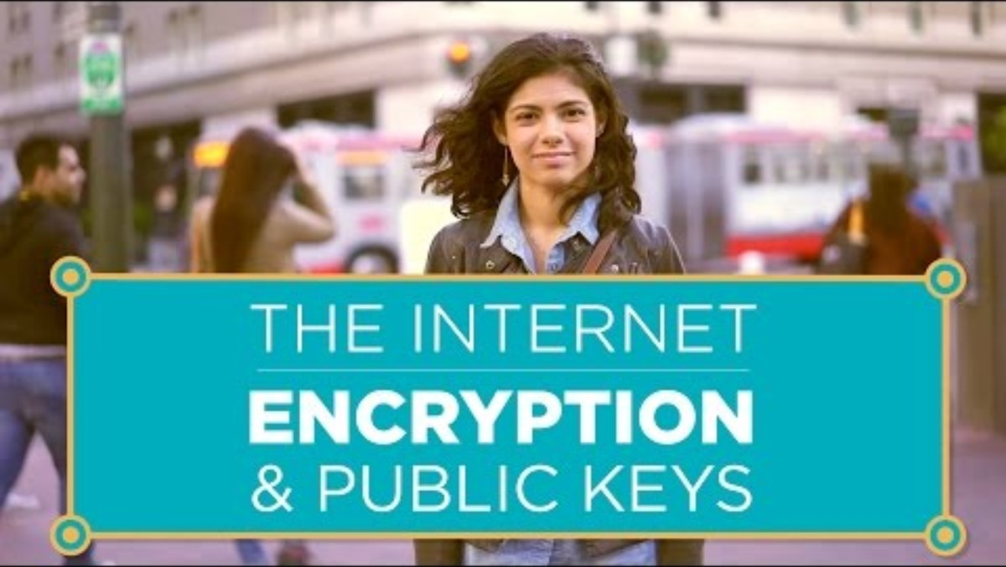
Introduction
Cipher
Encryption
Decryption
Caesar’s Cipher
Algorithm
Asymmetric Encryption
Notes:
https://youtu.be/ZghMPWGXexs?si=IVcGACRN74FnbgfS
The Lava Lamps That Help Keep The Internet Secure
https://www.youtube.com/watch?v=1cUUfMeOijg

Slide 4
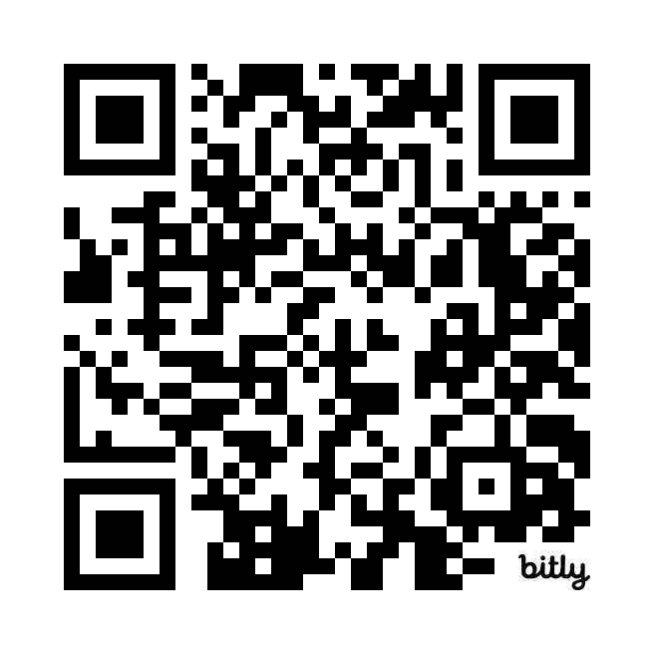
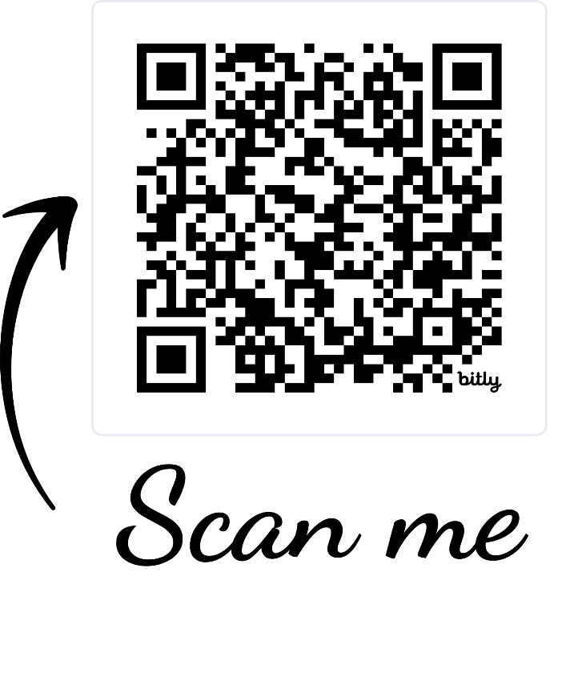

Activity 1: Cryptography
Use the link below to access a cipher wheel. Use the cipher wheel with a shift of 3 to decrypt part of the link below (in red). Once the link is decrypted, go to the link and download the zip file. The zip file will be password protected.
bit.ly/zpiqrzpx
bit.ly/csltucipherwheel
Notes:
https://studio.code.org/s/hoc-encryption/lessons/1/levels/1
Caesar Cipher Wheel

Slide 5
Activity 2: Solve the riddle to get an encrypted version of password of the zip file from activity 1. Use the Ceaser Cipher with 3-shifts again to decrypt the password and access the content of the zip file.
bit.ly/csltucipherwheel
Notes:
https://studio.code.org/s/hoc-encryption/lessons/1/levels/1
Caesar Cipher Wheel

Slide 6

Social Engineering
Activity 3: Detect Phishing Email
What makes this email a scam?
Examine the exhibit carefully and identify the
phishing email indicators.
Vevox - Dashboard
Notes:
Vevox - Dashboard

Slide 7
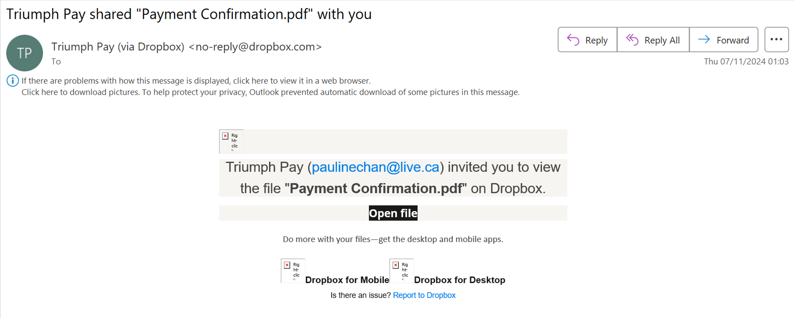
Notes:
Vevox - Dashboard

Slide 8
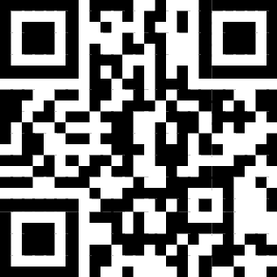
GITHUB CODE
Activity 4: Python code for phishing
Alternatively, you can scan the QR-code
Notes:
Navigate to this link: https://tinyurl.com/2zzpmksn

Slide 9


REPLIT Registration https://replit.com/

Slide 10

The Lava Lamps for Cyber Security
Random numbers
Passwords
Encryption key
Notes:
https://youtu.be/ZghMPWGXexs?si=IVcGACRN74FnbgfS
The Lava Lamps That Help Keep The Internet Secure
https://www.youtube.com/watch?v=1cUUfMeOijg

Slide 11
Any question?

